Slide 1

Spacex Flight Data analysis
Bonheur Mukulutake Mukosa
25 November 2024

Slide 2

OUTLINE
Executive Summary
Introduction
Methodology
Results
  Visualization – Charts
  Dashboard
Conclusion

Slide 3

EXECUTIVE SUMMARY
Summary of methodologies
- SpaceX Data Collection using SpaceX API
- SpaceX Data Collection with Web Scraping
- SpaceX Data Wrangling
- SpaceX Exploratory Data Analysis using SQL
- Space-X EDA DataViz Using Python Pandas and Matplotlib
- Space-X Launch Sites Analysis with Folium- Interactive Visual Analytics and Plotly Dash
- SpaceX Machine Learning Landing Prediction

Slide 4

INTRODUCTION
SpaceX advertises Falcon 9 rocket launches on its
website with a cost of 62 million dollars; other providers
cost upward of 165 million dollars each, much of the
savings is because SpaceX can reuse the first stage.
Therefore if we can determine if the first stage will land,
we can determine the cost of a launch. This information
can be used if an alternate company wants to bid
against SpaceX for a rocket launch.
In this capstone, we will predict if the Falcon 9 first
stage will land successfully using data from Falcon 9
rocket launches advertised on its website.

Slide 5

METHODOLOGY
Executive Summary
Data collection methodology:
- Describes how data sets were collected
Perform data wrangling
-Describes how data were processed
Perform exploratory data analysis (EDA) using visualization and SQL
Perform interactive visual analytics using Folium and Plotly Dash
Perform predictive analysis using classification models
-How to build, tune, evaluate classification models

Slide 6
Data Collection
• Description of how SpaceX Falcon9 data was collected.
• Data was first collected using SpaceX API (a RESTful API) by making a get request to the
SpaceX API. This was done by first defining a series helper functions that would help in the use
of the API to extract information using identification numbers in the launch data and then
requesting rocket launch data from the SpaceX API url.
• Finally to make the requested JSON results more consistent, the SpaceX launch data was
requested and parsed using the GET request and then decoded the response content as a
Json result which was then converted into a Pandas data frame.
• Also performed web scraping to collect Falcon 9 historical launch records from a Wikipedia
page titled List of Falcon 9 and Falcon Heavy launches of the launch records are stored in a
HTML. Using BeautifulSoup and request Libraries, I extract the Falcon 9 launch HTML table
records from the Wikipedia page, Parsed the table and converted it into a Pandas data frame

Slide 7
Data Collection – SpaceX API
• Data collected using SpaceX API (a RESTful API) by making a get request to the SpaceX API then requested and parsed the SpaceX launch data using the GET request and decoded the response content as a Json result which was then converted into a
Pandas data frame
Here is the GitHub URL

Slide 8
Data Collection - WebScraping
• Performed web scraping to collect Falcon 9 historical launch records from a Wikipedia using
BeautifulSoup and request, to extract the Falcon 9 launch records from HTML table of the Wikipedia page, then created a data frame by parsing the launch HTML.
Here is the GitHub URL

Slide 9
Data Wrangling
• After obtaining and creating a Pandas DF from the collected data, data was filtered using the
BoosterVersion column to only keep the Falcon 9 launches, then dealt with the missing data values in the LandingPad and PayloadMass columns. For the PayloadMass, missing data values were replaced using mean value of column.
• Also performed some Exploratory Data Analysis (EDA) to find some patterns in the data and determine what would be the label for training supervised models
Here is the GitHub URL

Slide 10
EDA with Data Visualization
• Performed data Analysis and Feature Engineering using Pandas and Matplotlib.i.e.
• Exploratory Data Analysis
• Preparing Data Feature Engineering
• Used scatter plots to Visualize the relationship between Flight Number and Launch
Site, Payload and Launch Site, FlightNumber and Orbit type, Payload and Orbit
Type.
• Used Bar chart to Visualize the relationship between success rate of each orbit
Type
• Line plot to Visualize the launch success yearly trend.
Here the GitHub URL

Slide 11
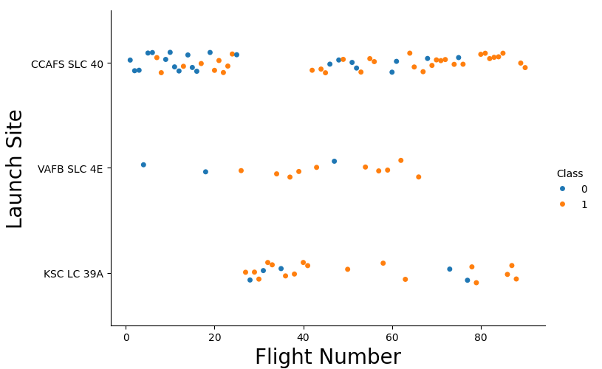
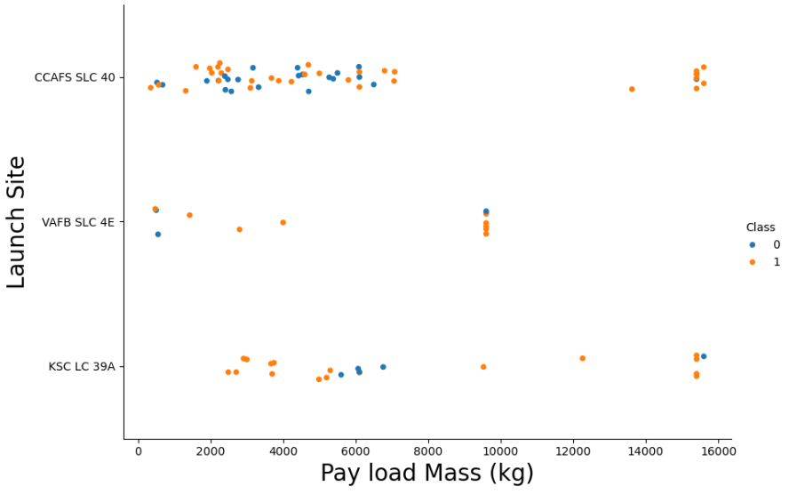
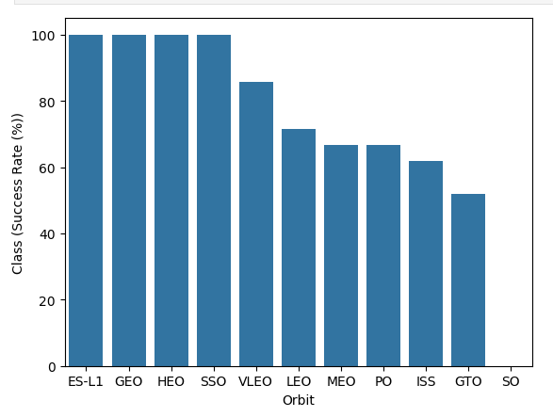
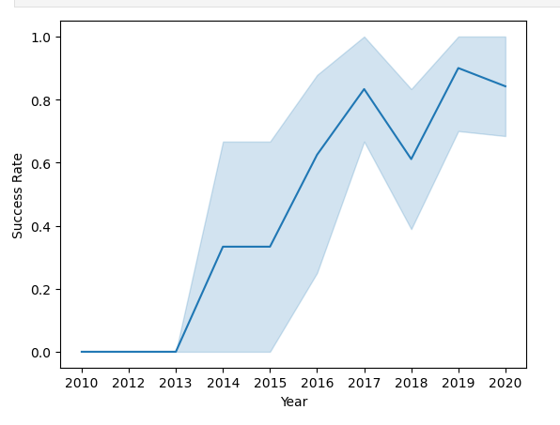
EDA with Data Visualization(Result)

Slide 12
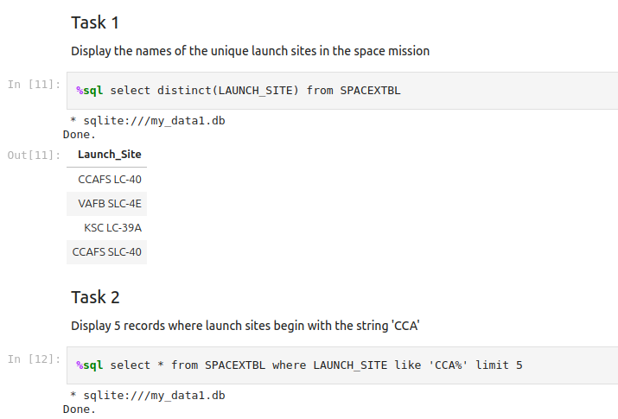
EDA with SQL
• The following SQL queries were performed for EDA

Slide 13
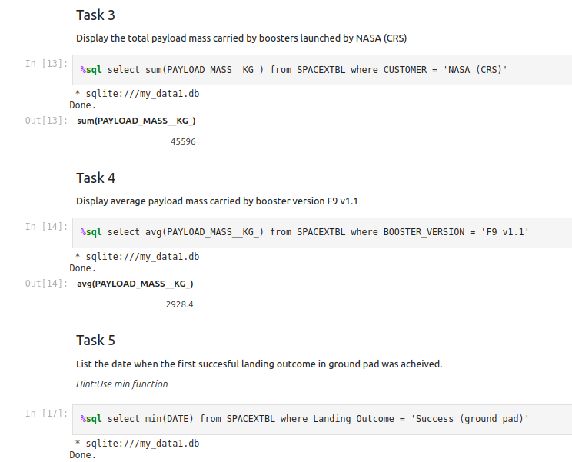
EDA with SQL (Cont.…)
Here is the GitHub URL

Slide 14
Build an Interactive Map with Folium
• Created folium map to marked all the launch sites, and created map objects such
as markers, circles, lines to mark the success or failure of launches for each
launch site.
• Created a launch set outcomes (failure=0 or success=1).
Here is the GitHub URL

Slide 15
Build a Dashboard with Plotly Dash
• Built an interactive dashboard application with Plotly dash by:
• Adding a Launch Site Drop-down Input Component
• Adding a callback function to render success-pie-chart based on selected site dropdown
• Adding a Range Slider to Select Payload
• Addeng a callback function to render the success-payload-scatter-chart scatter plot
Here is the Github URL

Slide 16
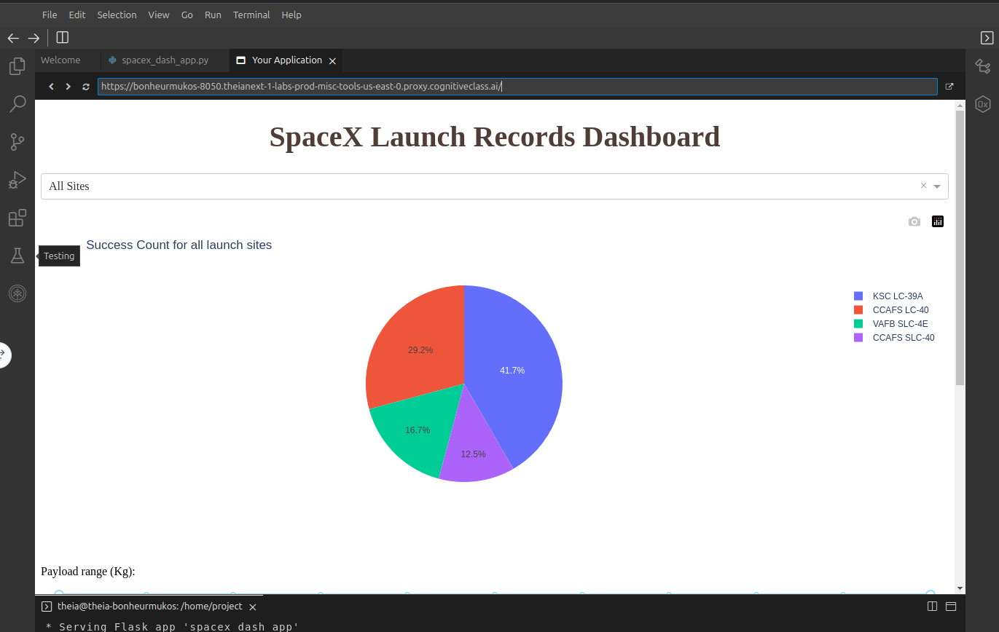
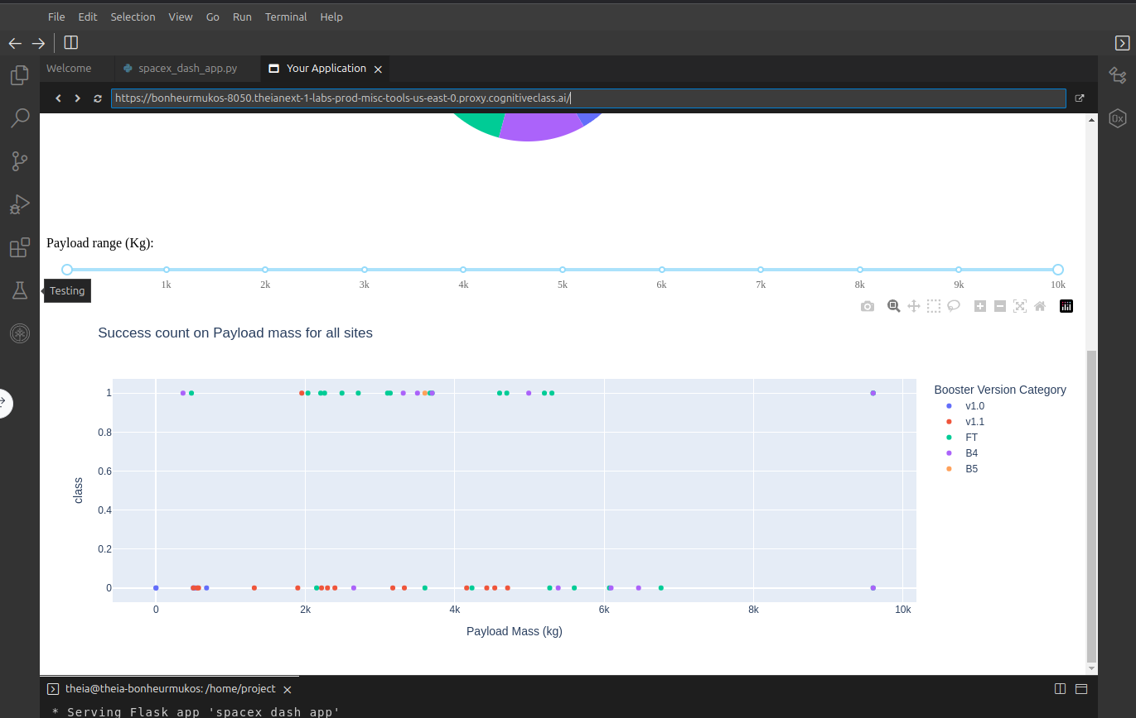
SpaceX Dash App

Slide 17
Predictive Analysis (Classification)
• Summary of how I built, evaluated, improved, and found the best performing classification model
• After loading the data as a Pandas Dataframe, I set out to perform exploratory Data Analysis and determine Training Labels by;
- creating a NumPy array from the column Class in data, by applying the method
to_numpy() then assigned it to the variable Y as the outcome variable.
- Then standardized the feature dataset (x) by transforming it using
preprocessing.StandardScaler() function from Sklearn.
- After which the data was split into training and testing sets using the function
train_test_split from sklearn.model_selection with the test_size parameter set to 0.2
and random_state to 2.
Here is the Github URL

Slide 18
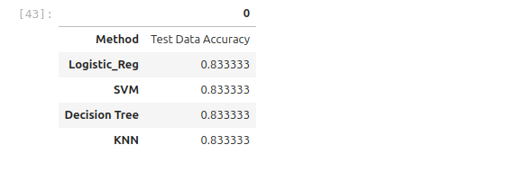
Predictive Analysis (Classification)
• The table below shows the test data accuracy score for each of the methods comparing them to show which performed best using the test data between SVM, Classification Trees, k nearest neighbors and Logistic Regression;

Slide 19
RESULTS
• Exploratory data analysis results
• Interactive analytics demo in screenshots
• Predictive analysis result

Slide 20
Conclusions
• Different launch sites have different success rates. CCAFS LC-40, has a success rate of 60 %,
while KSC LC-39A and VAFB SLC 4E has a success rate of 77%.
• We can deduce that, as the flight number increases in each of the 3 launcg sites, so does the
success rate. For instance, the success rate for the VAFB SLC 4E launch site is 100% after the
Flight number 50. Both KSC LC 39A and CCAFS SLC 40 have a 100% success rates after 80th
flight
• If you observe Payload Vs. Launch Site scatter point chart you will find for the VAFB-SLC
launchsite there are no rockets launched for heavypayload mass(greater than 10000).
• Orbits ES-L1, GEO, HEO & SSO have the highest success rates at 100%, with SO orbit having
the lowest success rate at ~50%. Orbit SO has 0% success rate.
• LEO orbit the Success appears related to the number of flights; on the other hand, there seems
to be no relationship between flight number when in GTO orbit

Slide 21
Conclusions Cont….
• With heavy payloads the successful landing or positive landing rate are more for
Polar,LEO and ISS. However for GTO we cannot distinguish this well as both positive
landing rate and negative landing(unsuccessful mission) are both there here
• Anf finally the sucess rate since 2013 kept increasing till 2020.

